Slide 1
Stock Data of FAANG
By: Sean Lee

Slide 2
Description of the Dataset:
https://www.kaggle.com/aayushmishra1512/faang-complete-stock-data
Dataset comes from the stock data of Facebook, Apple, Amazon, Netflix, and Google, starting from the day that these companies began to be publicly traded
Over 26,000 entities for all .csv files combined.
Attributes:
Volume
Maximum price
Minimum price
Adjusted closing price
Closing price
Volume

Slide 3
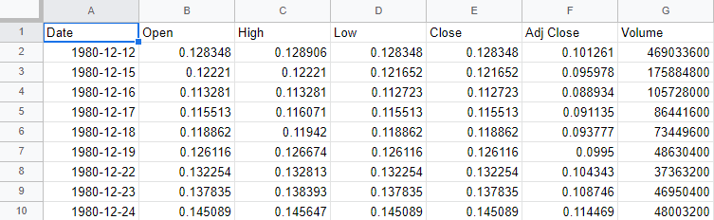
Example Dataset from Apple:
Dates Range from 12/12/1980 to 9/1/2020 for the Apple dataset
Each dataset includes the key information about a company’s stock price on that specific day
Adjusted closing price can be used as a better reflection of a stock’s actual value because it takes into account a stock’s dividends, stock splits, and new stock offerings

Slide 4
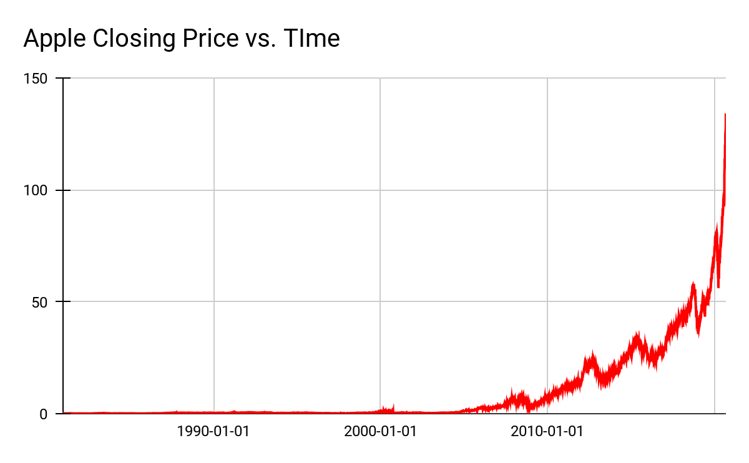
How Can This Data Be Used:
Each date includes all stock data necessary to make a detailed plot of the stock price and how it correlates to events in the market/ compares to other stocks
Upward or downward trends reflected in stock price can be compared with the FAANG dataset to see if the other technology stocks saw the same gains or losses
Data can be used to predict further changes in a stock’s price, and stock brokers can adjust their strategies accordingly to maximize profit and minimize loss

Slide 5
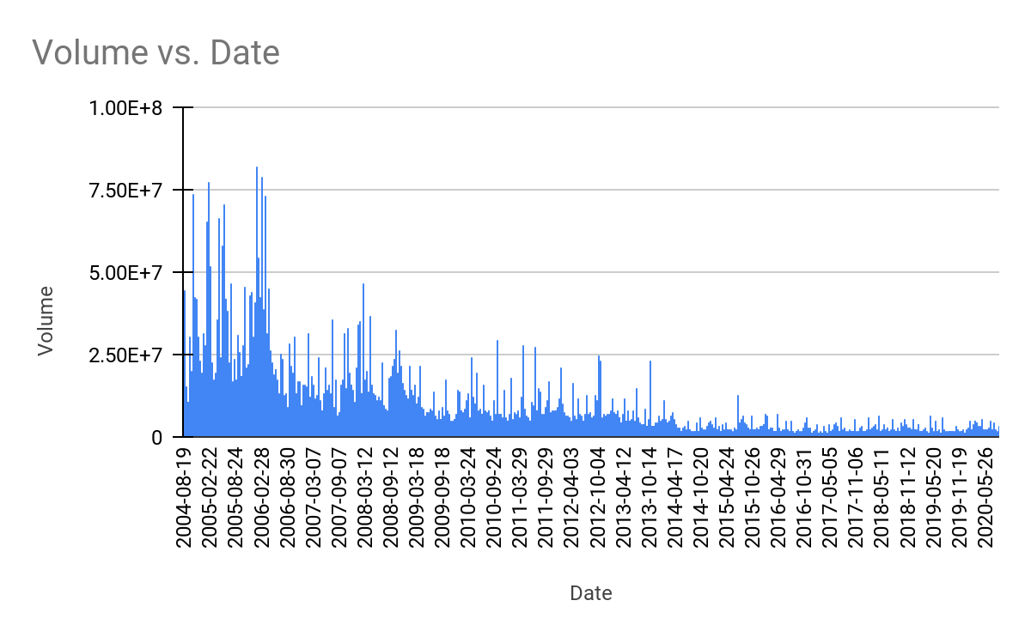
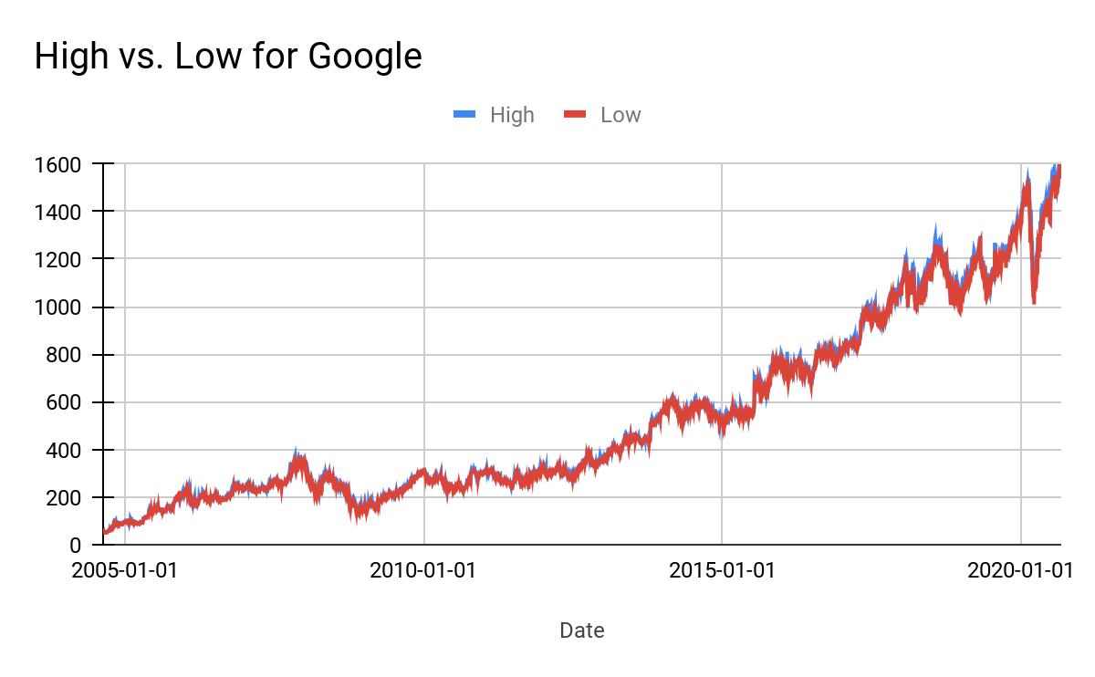
How Can This Data Be Used:
Graphs of the maximum and minimum price can show just how much a stock’s price may differ throughout a trading day
Trendlines can be established to estimate the general growth of a stock
These trendlines may also act as a predictor for future stock performance
Economists can use FAANG data as a benchmark to compare to other technology stocks and place a risk assessment on new stocks

Slide 6
Questions the Data Can Answer:
Data analysis can find correlations between datasets as to the best way to promote a stocks growth
Which stocks experienced the most growth/ loss over a certain period of time?
Graphs of the data can show how economic booms and recessions affected all stocks and which companies were affect the most
Finding similarities in FAANG that led to exponential growth over time could help new startup companies grow their business to be as successful as the ones in the dataset

